Slide 1
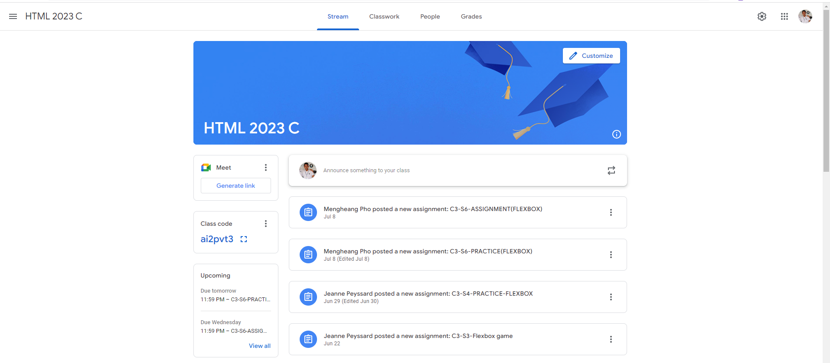
Identify root components of website below

Slide 2
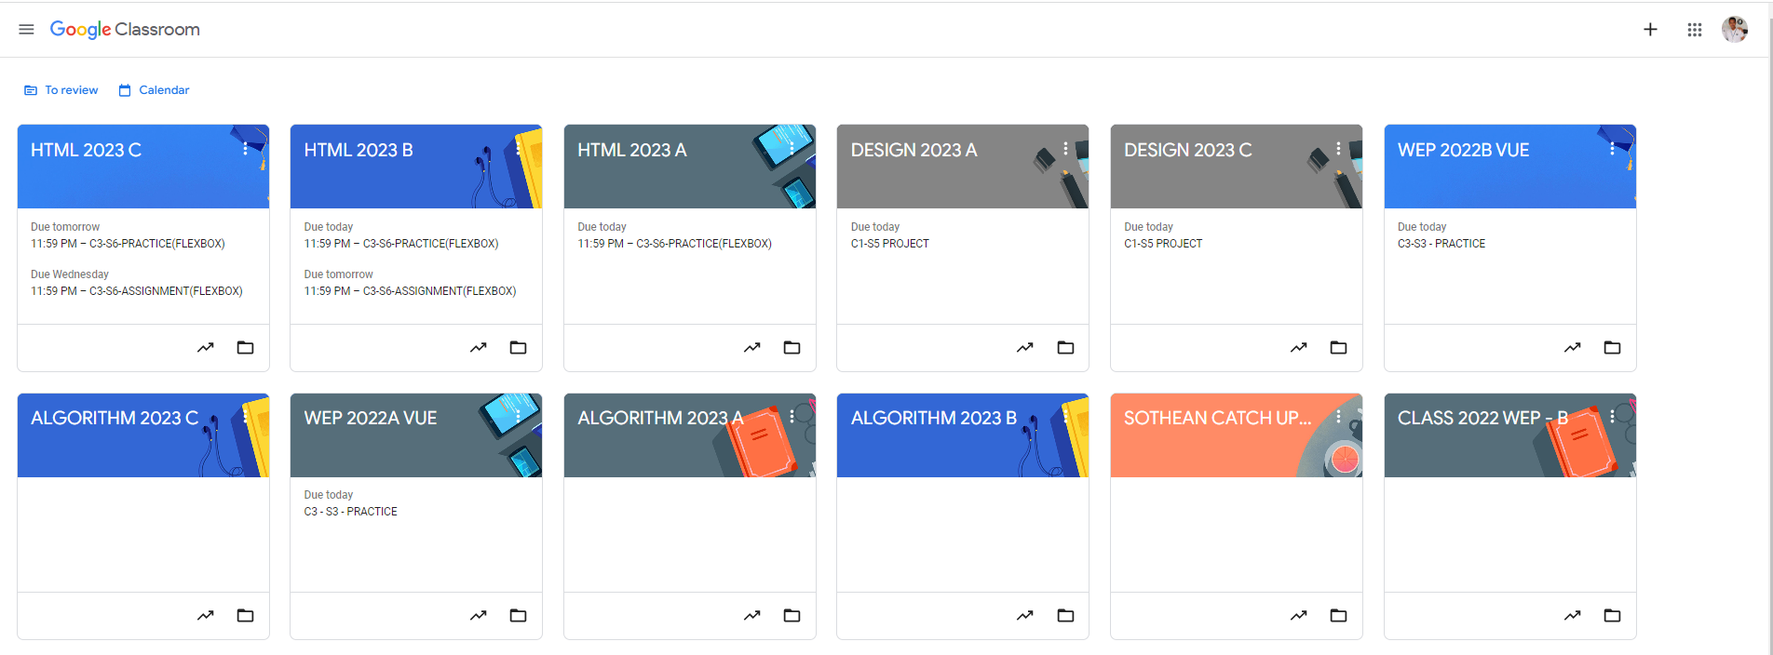
Root div
- Height: 100vh
content
nav
Flex: 0
header
Flex: 0
Flex: 1

Slide 3
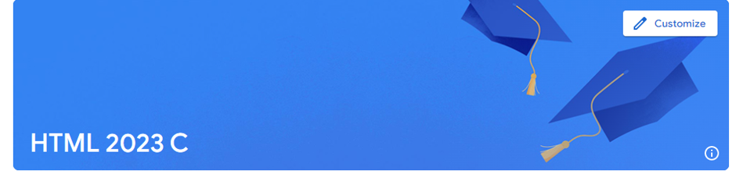
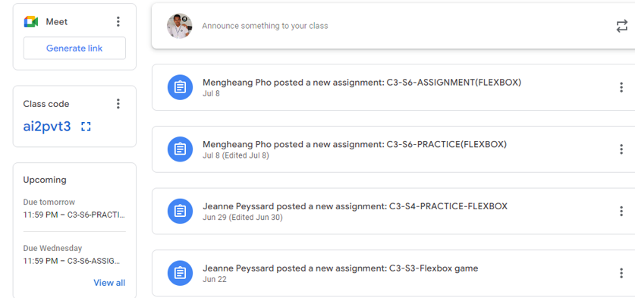
The negivation container
It display flex-direction : row
It has 3 other container in it and it use justify contain : space between and align item : center
This is the header container
The HTML thing is using justify-contain : flex end
While the customize is using justify contain flex-start and align item : flex end
The main right is using flex-direction : column and each item have gap
The side bar left also using flex-direction : column and each of it might be in the different
Container

